Slide 1

Control Structures: Iteration
Week 5 Hybrid Session 1

Slide 2
5.4: This Week
Hybrid 1
Peer Feedback Loops Sway
For Each Loop
While
Hybrid 2
Nested Loops
Nested Control Structures
Break and Continue

Slide 3

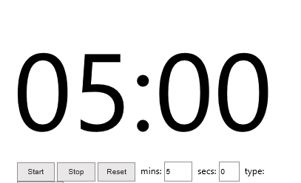
5 Minutes to Finalise Your Sway
Please send a link to your module tutor either in the call chat window

Slide 4
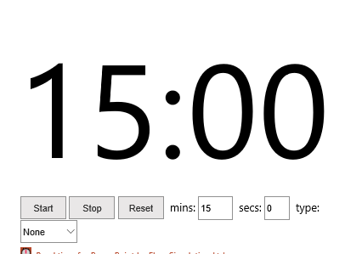
Peer Feedback

Slide 5
5.5: for-each Loop
Looping through a collection of items – i.e. a list
Structure is very similar to a for loop
for <<variable-name>> in [<<list>>]:
# code to repeat

Slide 6
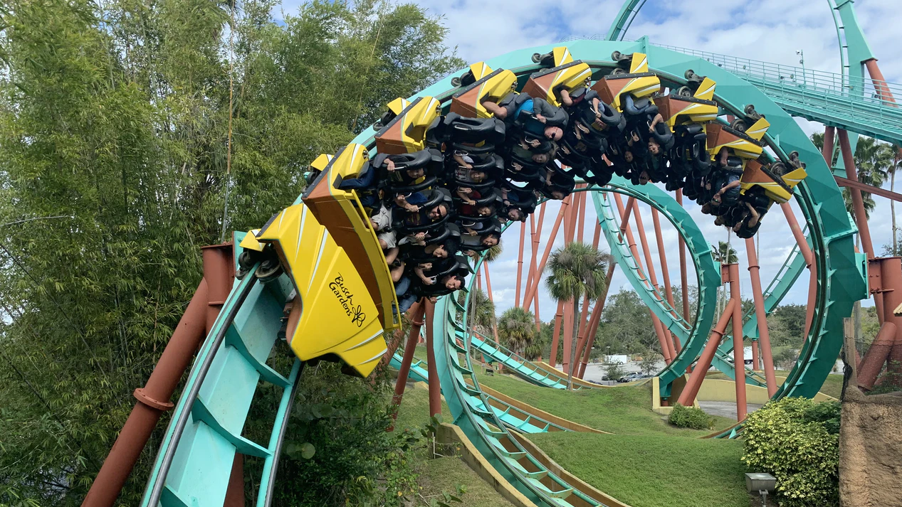
Demo
Implementing the For Each Loop

Slide 7

5.6: while Loop
Iterates until a particular condition is met
Keeps going until a goal is met
Often controlled by the “Sentry Variable”
Very real risk of entering an infinite loop
while(<<Boolean-condition>>):
# code to repeat

Slide 8

Demo
Implementing the while loop

Slide 9

Worksheet
Your turn to practice ☺

Slide 10
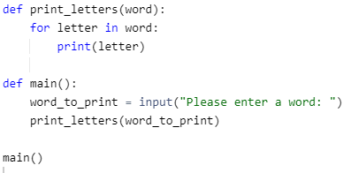
Solution (Question 1)

Slide 11
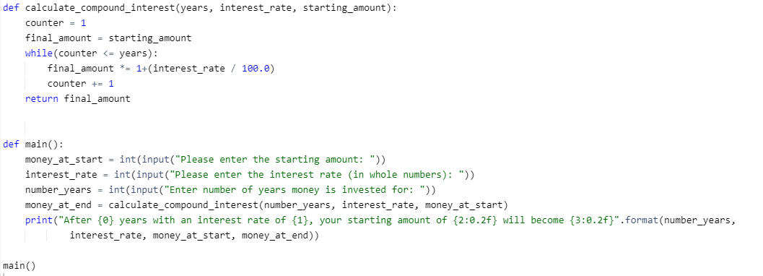
Solution (Question 5)

